Slide 1
CSE 130 – Algorithm Design Class 4
Winter 2023
Brother Godderidge

Slide 2

Opening Prayer

Slide 3
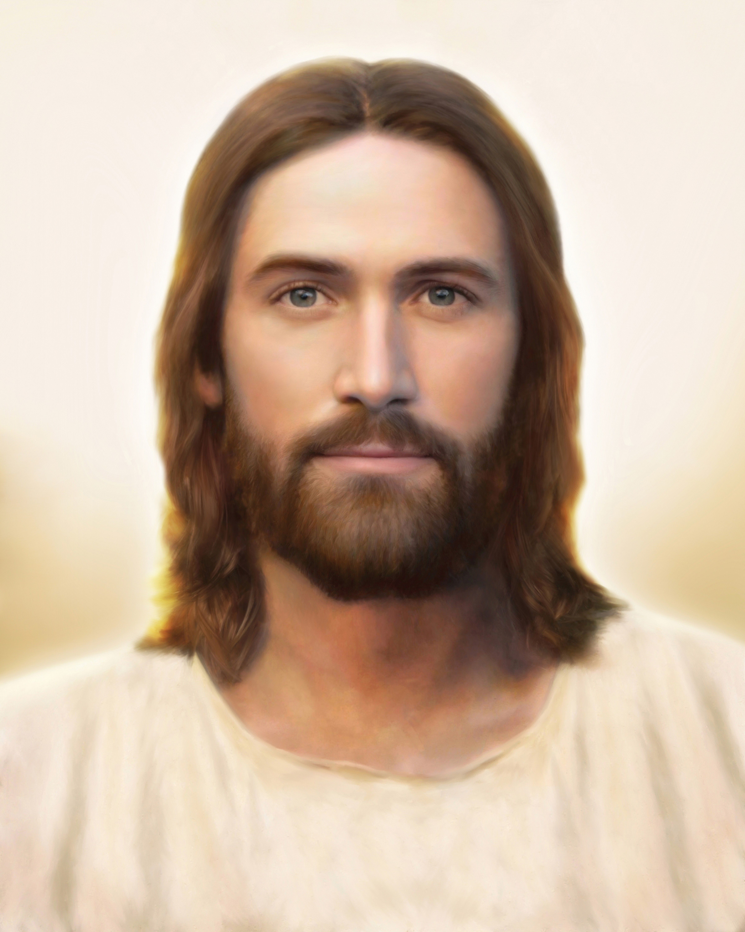
Spiritual Thought
JST John 1:16
16 For in the beginning was the Word, even the Son, who is made flesh, and sent unto us by the will of the Father. And as many as believe on his name shall receive of his fullness. And of his fullness have all we received, even immortality and eternal life, through his grace.
Notes:
What does it mean to be one? How can that apply to being a team? To Teamwork?

Slide 4

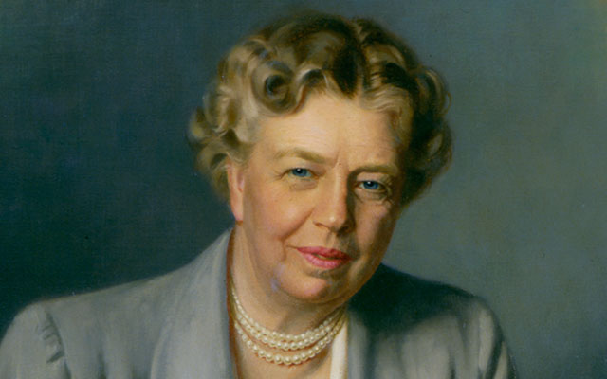
Quote
“Yesterday is History,
Tomorrow is a Mystery,
Today is a Gift,
That is why it’s called the Present.”
Master Oogway, Kung Fu Panda,
Eleanor Rossevelt
Carpe Diem
Seize the Day
Make the most of the present
Enjoy life while you can
Notes:
Show examples

Slide 5

Announcements
Thursday, January 12th, 11:30 am, STC Lobby, CSE/CIT Meet and Greet
Holiday – Monday January 16, 2023 – NO CLASSES!!
BYU STEM Career Fair
When: Thursday, January 26
Leave BYU-Idaho at 6:00 a.m.
10:00 a.m. – 5:30 p.m. attend the fair and interviews
Leave BYU-Provo at 6:00 p.m. arriving back in Rexburg around 11:00 p.m.
100 seats available, first come first served
Must register and sign the activity waiver to secure a seat!
To register please visit https://byui.joinhandshake.com/jobs/7360166/share_preview
Application Deadline is January 21 at midnight
Announcements from the class

Slide 6
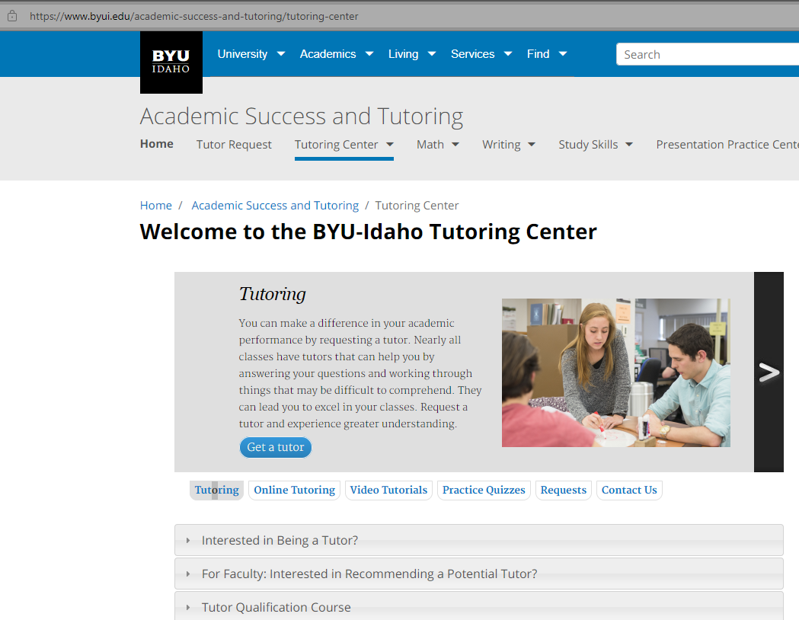
Tutoring Available
Welcome to the BYU-Idaho Tutoring Center (byui.edu)

Slide 7
University Help Resources
Dean of Students Office (byui.edu)
Kimball 290
208-496-9200
BYU-Idaho Counseling Center (byui.edu)
Student Health Center
208-496-9370
After hours – 24/7: 208-496-HELP(4357)
BYU-Idaho Wellness Center (byui.edu)
174 Hart building
208-496-7491
Welcome to the BYU-Idaho Tutoring Center (byui.edu)
2nd floor of the library
208-496-4270
Therapy Assistance Online (TAO): BYU-Idaho Counseling Center (byui.edu)
Online software to help
BYU-Idaho Student Health Center (byui.edu)
Health care and Pharmacy
208-496-9330
Autism Mentoring Program: BYU-Idaho Counseling Center (byui.edu)
Peer Mentoring (byui.edu)
208-496-1441
Many groups and workshops (contact counseling center)

Slide 8
University Help Resources
Student Services
Student Services (byui.edu)
Career services
Career Center (byui.edu)
208-496-9801
MC 200
Alumni Service
Alumni Association | Graduation Office | BYU-Idaho (byui.edu)
208-496-3300
MC 175
Presentation Practice Center:
Presentation Practice Center | Improve Your Public Speaking | BYU-Idaho (byui.edu)
208-496-3719
presentationpractice@byui.edu
IT
IT Services Home (byui.edu)
208-496-1411
Academic Advisor:
Email: CPSEadvising@byui.edu
208-496-9800
https://byu-idaho.screenstepslive.com/s/iplan_help_guides/m/68348/l/1021897-for-students-advising-appointment

Slide 9
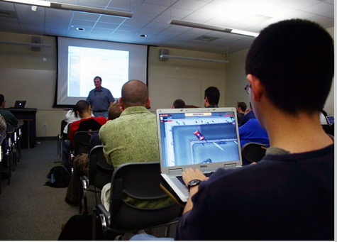
Class Rules
Talking – only one person at a time
Technology – Use for class
No games
No shopping
No videos
Class Roll
Notes:
Slide 12 - Communication
Email, Ilearn Announcements, MS Teams Channel
I-Learn Notifications - show how to set announcements to immediate – so will receive an email.
MS Teams Channel - meant for broad discussions - questions and answers from all.
Have teams installed? Should have received and invite from Teams for this channel.

Slide 10
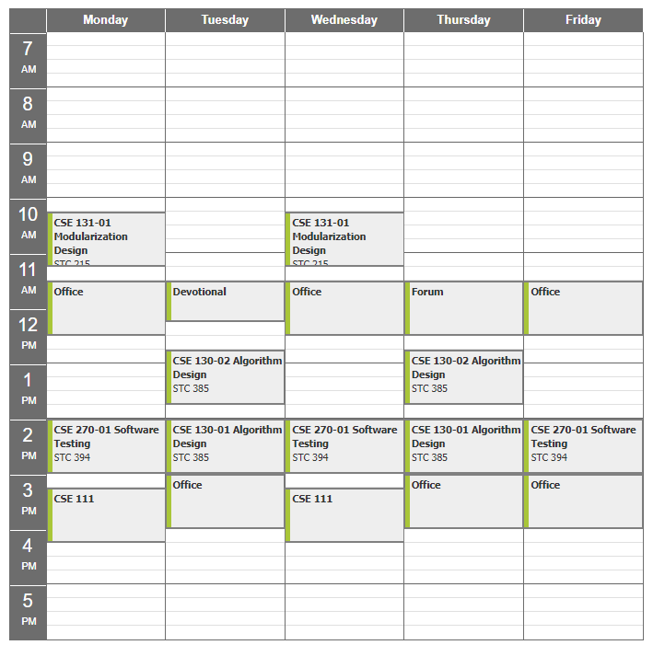
Gary Godderidge
Email: godderidgeg@byui.edu
Office Phone: 208-496-7617
Office Rm: 330 J
Office hours: See Schedule at
https://web.byui.edu/Directory/Employee/godderidgeg
MWF 11:30 am
TRF 3:00-4:00 pm
Anytime – contact me or knock on door
From Google: search for: “byui Godderidge”
Select schedule

Slide 11

Goals for Today
Python Review
JSON Review
Python slicing

Slide 12
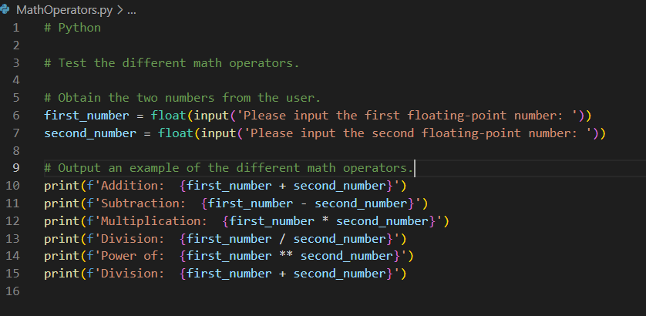
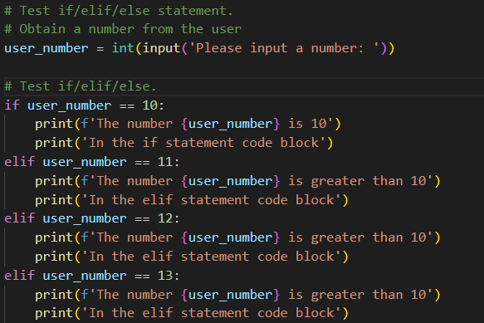
Coding Style/Standard
Variables Names – name it what it is, use underscores to separate words
E.g.,: last_name,
Spaces – use space before and after each operator:
E.g.,: rectangle_area = length * width
Blank Lines
Comments
One comment and one blank line per thought/idea
Code Blocks are indented by 4 spaces

Slide 13
CSE 130 Course Outline
Week | Topic | Homework
1 | Course Overview | Guessing Game
2 | Python Review | Authentication Program
3 | Flowchart | Monopoly Design
4 | Decisions | Monopoly Program
5 | Pseudocode | Advanced Search Design
6 | Efficiency | Advanced Search Program
7 | Trace | Sort Design
8 | Assert | Sort Program
9 | Collections | Numerical Sequence Design
10 | Loops | Numerical Sequence Program
11 | Maintainability | Prime Design
12 | Final Review | Prime Program
13 | Course Conclusion/Review | Final Exam or Final Exam Prep
14 | Final Exam – if needed
Notes:
Slide 12 - Communication
Email, Ilearn Announcements, MS Teams Channel
I-Learn Notifications - show how to set announcements to immediate – so will receive an email.
MS Teams Channel - meant for broad discussions - questions and answers from all.
Have teams installed? Should have received and invite from Teams for this channel.

Slide 14
Python – Sets, Tuples, List, and Dictionaries
All are used to store multiple data values in a single variable
Set – collection of unordered, unchangeable, and unindexed
Can add and remove items, but set items are not changeable
Not subscriptable – can’t use [index]
example_set = {“apple”, “banana”, “cherry”}
Tuple – collection which is ordered and unchangeable
example_tuple = (“apple”, “banana”, “cherry)
List – collection which is ordered, changeable, and allows duplicate values
example_list = [“apple”, “banana”, “cherry”]
Dictionary – key:value pairs, collection which is ordered, changeable, does not allow duplicates
example_car_dictionary = { “brand” : ”Ford”, “model” : ”Mustang, “year” : 1964}
Very similar to JSON
Python Tutorial (w3schools.com)

Slide 15
JSON Overview
JSON – JavaScript Object Notation
JSON is a syntax for storing and exchanging data
“name”:value
Rules for JSON syntax are:
Data should be in key(name)/value pairs
Data should be separated by commas
Curly braces should hold objects
Square brackets hold arrays
DataTypes include:
Number
String – Double quoted string
Boolean – true/false
Null
Object – Collection of key-value pairs enclosed in { }
Array – Ordered sequence of values enclosed in [ ]
Keys can be: Strings, numbers, or identifier names
{“name”:”John”}
{name:”John”}
JSON Tutorial: Learn with Simple File Format EXAMPLE (guru99.com)
JSON - Quick Guide (tutorialspoint.com)
JSON Data Types (w3schools.com)

Slide 16
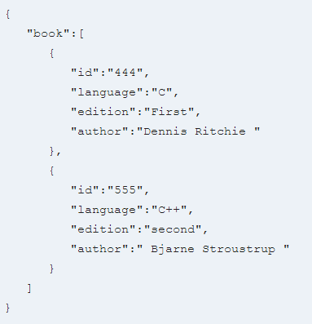
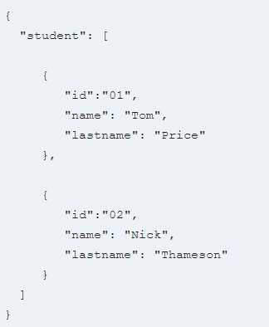
JSON Example
JSON Tutorial: Learn with Simple File Format EXAMPLE (guru99.com)
JSON - Quick Guide (tutorialspoint.com)
JSON Data Types (w3schools.com)

Slide 17
JSON Within Python
Within Python, data is a dictionary
Convert to JSON before writing to JSON text file using json.dumps()
JSON text file can be given to other applications
To read JSON data into python program
Read data from file as a string
Convert JSON string to python dictionary using json.loads()
Use like normal dictionary

Slide 18
JSON Within Python
import json
# This file will test JSON data and dictionaries.
test_dictionary = {
'Name' : 'Uncle Bob',
'Age' : 57,
'Home': 'Rockport',
'Hobby1': 'Rock Climbing'
}
print(test_dictionary)
print(test_dictionary['Name'])
json_string = json.dumps(test_dictionary)
with open('JSONExampleTake3.json', 'w') as file_handle:
file_handle.write(json_string)
with open('JSONExampleTake3.json', 'r') as file_handle:
json_string = file_handle.read()
print(json_string)
json_dictionary = json.loads(json_string)
print(json_dictionary['Name'])

Slide 19
Python Slicing
# Python
# This is a slicing example
test_string = 'ABCDEFGHIJKLMNOPQRSTUVWXYZ0123456789'
print(test_string[:5])
print(test_string[10:15])
print(test_string(10:5])
print(test_string[-9:-3])
print(test_string[:]
OUTPUT:
ABCDE
KLMNO
123456
ABCDEFGHIJKLMNOPQRSTUVWXYZ0123456789
Format/Syntax: test_string[start_index:end_index]
[:5] # characters 0-4
[10:15] # characters 10-14
[10:5] # Blank – start at character 10 and print nothing
[-9:-3] # index 9 from the end to index 3 from the end
[:] # prints entire string

Slide 20

Lighten Up
What is the best sport in Minecraft?
Boxing – The Ultimate dad Joke Book
When is it hardest to get rid of debt?
When you can budge it - ibid
How many programmers does it take to install a light bulb?
None, it’s a hardware problem– ibid
The sign by the minister’s parking spot at a church in Senath, Missouri, cleverly kept parishioners moving:
“You Park, You Preach” – Laughter really is the best medicine
Golfer asks his Caddy – how would you have played that last shot?
Caddy: Under an assumed name.– The world’s greatest collection of clean jokes.
The first time I got a universal remote, I thought to myself:
“This changes everything.” The Best Joke Book Ever.
Interesting Sign at an Electric Company: “We would be De-Lighted if you send in your payment for your bill.”
“However, if you don’t, you will be.”– Healing through humor
Notes:
The computer will run the instructions one at a time – in order. Line upon line.
As in our previous examples, the computer runs our code in order.
Show another example.

Slide 21
Lighten Up
What did the Knock-Knock Joke Writer Win?
The no-bell prize ☺ - The Ultimate Dad Joke Book
During a company-held workshop on emergencies, our instructor asked: What would you do if you received a letter Bomb?
One guy said: “Write: Return to Sender” - Reader’s Digest Laughter is the best medicine
I once had a boss tell me: “Don’t dress for the job you have, dress for the job you want”.
I showed up the next data in a Chicago Cubs Uniform – ibid.
Notes:
IMPORTANT – STOP AND SHOW examples

Slide 22
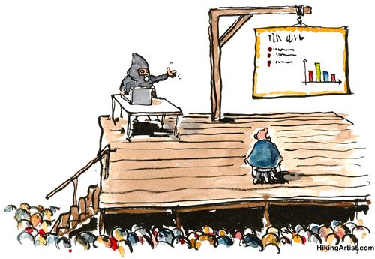
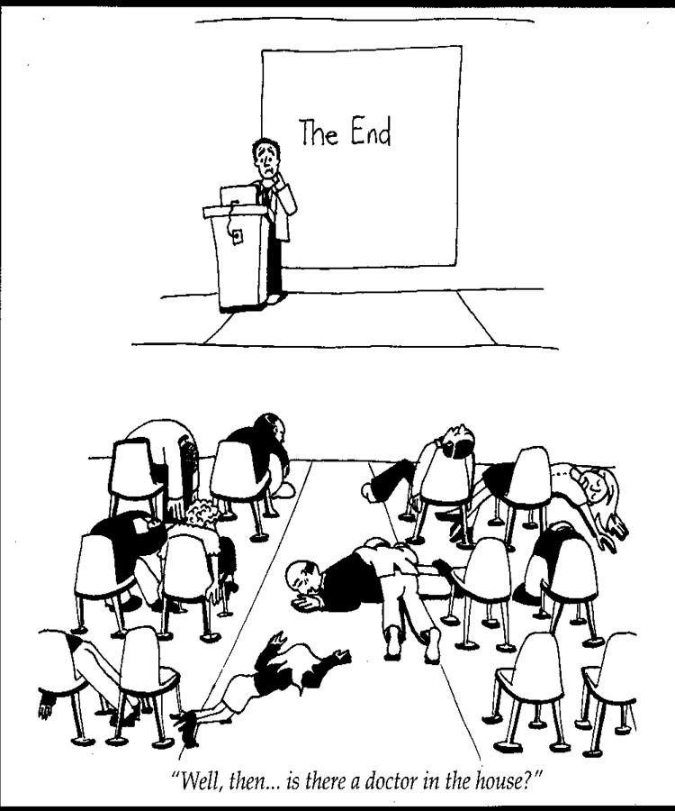
Death . . . By PowerPoint

